Slide 1
Notes:
Good morning. My thesis addresses the critical challenge of protecting Personally Identifiable Information, or PII, in the rapidly expanding use of Large Language Models. The goal is to develop a robust, client-side privacy solution that balances security with the necessity for real-time performance.

Slide 2



Motivation & Stakes
$4.88 M average cost per Incident in corporate settings.
High Cost of Breaches: The global average cost of a data breach hit a record peak of 4.88 million in 2024.
Growing Privacy Concern: Anyone chatting with AI chatbots is skeptical about potential information leakage or misuse.
LLMs are "highly prone to retaining and copying PII from the input when prompted" (up to 57.4% leakage in studies)
Regulatory Pressure: AI systems must incorporate robust privacy mechanisms due to frameworks like the EU’s AI Act, US Executive Order, GDPR, and HIPAA.
Notes:
The adoption of LLMs in sensitive domains like finance and healthcare creates acute privacy risks. Unprotected user prompts can leak sensitive PII to server-side LLMs. In one of the study it is projected that 57.4% of the data can be potentially leaked by LLM’s. Look at this number, that’s the avg cost per incident for a data breach, wow significantly high. The financial and healthcare sectors are under acute threat, reinforcing the need for advanced defense mechanisms Regulatory frameworks make developing practical, efficient, local privacy solutions paramount.

Slide 3
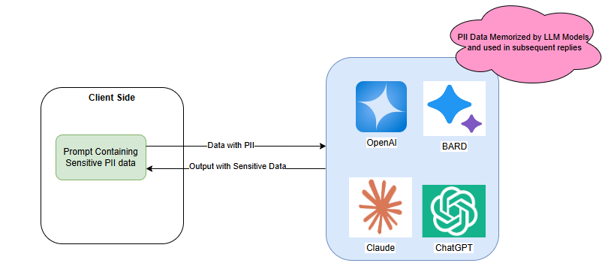
Existing Limitations and Research Gap
Offer strong privacy but impose significant computational overhead and latency (e.g., 1000x slower).
Perturbation Methods (DP): Improve scalability but struggle with the privacy-utility trade-off, often leading to diminished accuracy and unreliable outputs.
SnD Framework: Lacks integrated Named Entity Recognition (NER), risking leakage of identifiable entities.
Gap: Need for a robust, practical, and efficient client-side solution that guarantees privacy without sacrificing model performance
Notes:
Current solutions force a painful trade-off. Cryptographic techniques are too slow for real-time applications. Differential Privacy degrades output quality due to excessive noise. This research directly addresses this critical gap by focusing on a client-side, NER-driven solution that avoids these performance and utility pitfalls

Slide 4
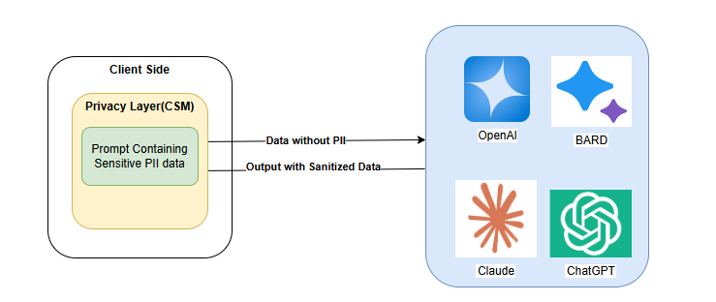
Introducing CSM(Clean Split Model)
CleanSplit Model (CSM): A novel privacy-preserving inference framework.
Aim: Develop a novel framework for efficiently protecting PII in LLM inference. CSM Core: A novel, privacy-preserving inference framework
Objective: Optimize the trade-off between privacy preservation and computational utility.
Mechanism: Deploys a lightweight token representation layer on the client side. Uses NER to detect and replace sensitive entities prior to server interaction
Notes:
Our proposed solution is the CleanSplit Model, or CSM. The core objective is protection without modifying existing server model parameters. CSM ensures that raw PII is never transmitted to the LLM servers. This is achieved by incorporating a Named Entity Recognition (NER)-driven approach for detection and synthetic replacement. This design choice is fundamental to achieving efficiency and compliance.
The challenge addressed by the CSM framework is analogous to a postal worker sorting mail inside your house before it leaves, rather than trusting the entire postal system.

Slide 5
Research Objectives & Alignment
Notes:
My research was structured around three fundamental questions. First, how efficiently can NER be deployed client-side? Second, how does PII replacement affect response quality? And third, how do we balance privacy with contextual continuity in complex conversations? These RQs align precisely with our objectives: reviewing existing methods, developing the client-side NER replacement system, and benchmarking the architecture against utility and performance

Slide 6
Methodology: Experimental Conditions

